Slide 1
Arithmetic Micro-operations

Slide 2
Arithmetic Microoperations
A microoperation is an elementary operation performed with the data stored in registers.
The microoperations most often encountered in digital computers are classified into four categories:
  Register transfer microoperations (on binary information)
  Arithmetic microoperations (on numeric data stored in the registers)
  Logic microoperations (bit manipulations on non-numeric data)
  Shift microoperations

Slide 3
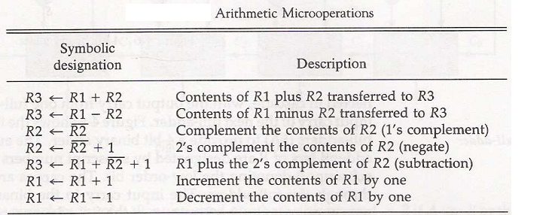
Arithmetic Microoperations
The basic arithmetic microoperations are: addition, subtraction, increment, and decrement.

Slide 4
Arithmetic Microoperations
The arithmetic microoperations change the information content.
Addition Microoperation:
R3 ←R1+R2
Subtraction Microoperation:
R3 ←R1-R2 or :
R3 ←R1+R2+1
1’s complement

Slide 5
Arithmetic Microoperations
One’s Complement Microoperation:
R2 ←R2
Two’s Complement Microoperation:
R2 ←R2+1
Increment Microoperation:
R2 ←R2+1
Decrement Microoperation:
R2 ←R2-1

Slide 6
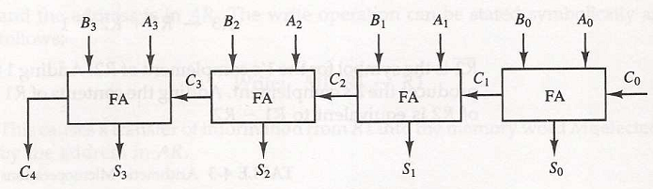
Arithmetic Microoperations:
Binary Adder
A binary adder is constructed with full-adder circuits connected in cascade, with the output carry from one full-adder connected to the input carry of the next full-adder.
Fig: 4-bit binary adder

Slide 7
Arithmetic Microoperations:
Binary Adder
4 data bits for the A inputs come from one register.
4 data bits for the B inputs come from another register.
The augend bits of A and the addend bits of B are designated by subscript numbers from right to left, with subscript 0 denoting the low-order bit.
The input carry to the binary adder is C₀ and the output carry is C₄.
The output carry from each full-adder is connected to the input carry of the next-high-order full-adder.

Slide 8
Arithmetic Microoperations:
Binary Adder
4-bit binary adder is constructed with interconnection of four full-adders (FA).
An n-bit binary adder requires n full-adders.
The n data bits for the A inputs come from one register.
The n data bits for the B inputs come from another register.
The sum can be transferred to a third register or one of the source registers, replacing its previous content.

Slide 9
Arithmetic Microoperations:
Binary Adder-Subtractor
The subtraction A-B can be done by taking the 2’ complement of B and adding it to A. The 2’s complement can be obtained by taking the 1’ complement and adding one to the least significant pair of bits.
The 1’ complement can be implemented with inverters and a one can be added to the sum through the input carry.
The addition and subtraction operation can be combined into one common circuit by including an exclusive-OR gate with each full-adder.

Slide 10
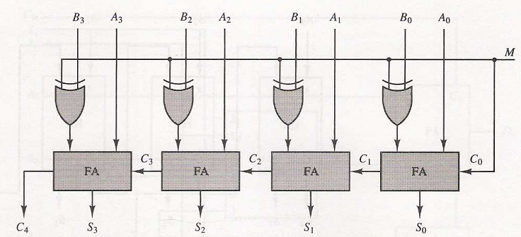
Arithmetic Microoperations:
Binary Adder-Subtractor
The mode input M controls the operation.
When M=0 the circuit is an Adder and when M=1 the circuit becomes a Subtractor.
Fig: 4-bit Adder-Subtractor

Slide 11
Arithmetic Microoperations:
Binary Adder-Subtractor
Each exclusive-OR gate receives input M and one of the input of B.
When M=0, we have B ⊕ 0=Β.
The full-adder receive the value of B, the input carry C₀ is 0, and the circuit performs A plus B.
When M=1, we have B ⊕ 1=B’ and C₀ =1.
The inputs are all complemented and a 1 is added through the input carry C₀.
The circuit performs the operation A plus the 2’s complement of B.

Slide 12
Arithmetic Microoperations:
Binary Adder-Subtractor
For unsigned numbers, this gives A – B if A≥B
provided that there is overflow or
For signed numbers, the result is A – B provided that there is no overflow.
the 2’s complement of the result if A < B
(example: 3 – 5 = -2= 1110)

Slide 13
Arithmetic Microoperations:
Binary Incrementer
The increment microoperation adds one to a number in a register.
Binary Incrementer can also be implemented using a counter.
A incrementer can be accomplished by half-adders (HA) connected in cascade.

Slide 14
Arithmetic Microoperations:
Binary Incrementer
A₃
A₂
A₁
A₀
1
x
y
x
y
x
y
x
y
HA
HA
HA
HA
C
S
C
S
C
S
C
S
C₄
S₃
S₂
S₁
S₀
Fig: 4-bit Binary Incrementer

Slide 15
Arithmetic Microoperations:
Binary Incrementer
One of the input to the least significant half-adder (HA) is connected to logic-1.
The output carry from one half-adder is connected to one of the input of the next-higher-order half-adder.
The circuit receives the four bits from A₀ through A₃, adds one to it, and generates the incremented output in S₀ through S₃.
An n-bit binary incrementer can be extended by including n half-adders.

Slide 16
4-4 Arithmetic Microoperations:
Binary decrementer
A binary decrementer can be implemented by adding 1111 to the desired register each time.

Slide 17
Arithmetic Microoperations:
Arithmetic Circuit
Arithmetic circuit performs seven distinct arithmetic operations and the basic component of it is the parallel adder.
By controlling the data inputs to the adder, it is possible to obtain different types of arithmetic operations.
The output of the binary adder is calculated from the following arithmetic sum:
    D = A + Y + C_{in}

Slide 18
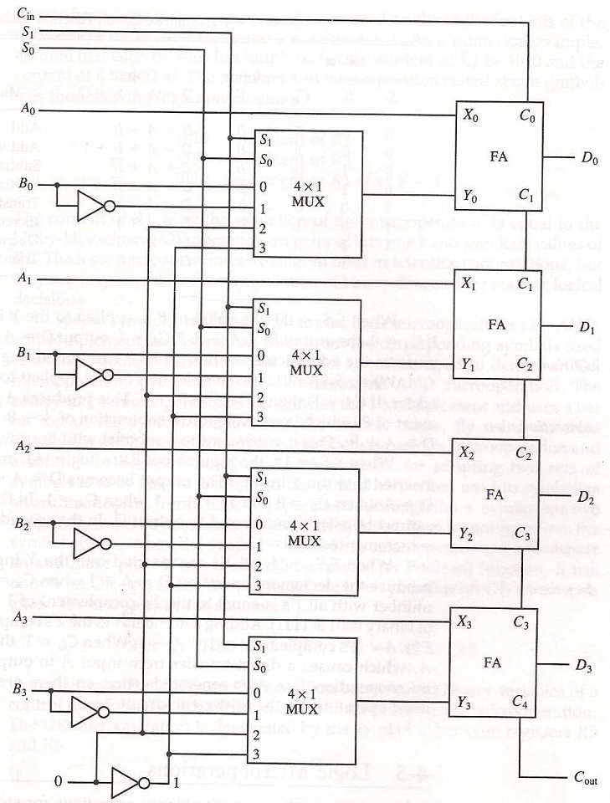
Arithmetic Microoperations:
Arithmetic Circuit

Slide 19
Arithmetic Microoperations:
Arithmetic Circuit
4-bit Arithmetic circuit has four full-adder circuits that constitute the 4-bit adder and four multiplexers for choosing different operations.
There are two 4-bit inputs A and B and a 4-bit output D.
The four inputs from A go directly to the X inputs of the binary adder.
Each of the four inputs from B are connected to the data inputs of the multiplexers.
The multiplexers data inputs also receive the complement of B.

Slide 20
Arithmetic Microoperations:
Arithmetic Circuit
The other two data inputs are connected to logic-0 and logic-1.
The four multiplexers are controlled by two selection inputs S₁ and S₀. The input carry C_{in}, goes to the carry input of the FA in the least significant position. The other carries are connected from one stage to the next.
By controlling the value of Y with the two selection inputs S₁ and S₀ and making C_{in} equal to 0 or 1, it is possible to generate the eight arithmetic microoperations

Slide 21
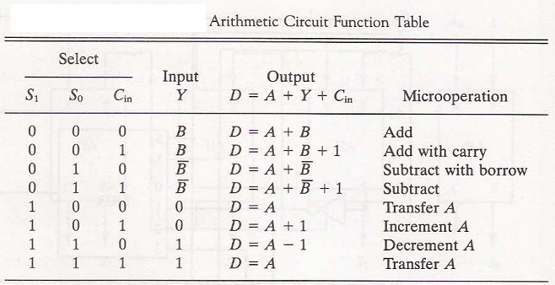
Arithmetic Microoperations:
Arithmetic Circuit

Slide 22
Arithmetic Circuit

